Slide 1


Department of Computer Science and Engineering
PREDICTING POVERTY LEVEL FROM SATELLITE IMAGERY
SINEKA V 211419104254
VINOTHINI P 211419104306
SRUTHI R 211419104270
Guide Name & Designation
Coordinator Name & Designation
Dr.K.VALARMATHI M E,Ph D,
Dr.K.VALARMATHI M E,Ph D,

Slide 2
INTRODUCTION
Determining the poverty levels of various regions throughout the world is crucial in identifying interventions for poverty reduction initiatives and directing resources fairly.
However, reliable data on global economic livelihoods is hard to come by, especially for areas in the developing world, hampering efforts to both deploy services and monitor/evaluate progress.
This project proposes to use satellite images to detect economic activity and, as a result, estimate poverty in a location.
A Recurrent neural network is trained to learn various developmental parameters like rooftop type, source of lighting and proximity to water sources, Agriculture Areas, Road Structure, Industrial Areas.

Slide 3
OBJECTIVES OF THE PROJECT
The project comprises of detecting the poverty level by using a satellite imagery Using a recurrent neural network.
The splits were executed on the country level to ensure that data from the same country is not in more than one set.
Furthermore, the splits were consistent across daytime and nighttime images meaning that daytime and night time images of the same region were in the same split, ensuring consistency in reporting metrics across daytime and nighttime experiments
This will help philanthropic agencies and government to identify where resources and interventions are needed and help guide the direction of financial aid and Frequent and reliable data on poverty levels and distribution allows agencies to better track progress on the Sustainable Development Goals.

Slide 4
LITERATURE SURVEY
YEAR | TITLE | author | description | ADVANTAGE | DISADVANTAGE
2023 | Using Convolutional Neural Networks on Satellite Images to Predict Poverty. | Arwa Okaidat, Shatha Melhem, Heba Alenezi and Rehab M. Duwairi. | This paper focuses on Africa as it is considered the poorest continent. The data, we have used, consist of three datasets which contain satellite images for three countries in Africa with different levels of poverty: Ethiopia, Malawi, and Nigeria. In order to classify the satellite images, two pre-trained Convolutional Neural Networks models (ResNet50 and VGG16) were implemented in addition to our novel structure of CNN. | Deep learning with satellite images provides a scalable way to make predicting the distribution of poverty faster, easier, and less expensive. | The process of going around rural areas and manually tracking census data is time-consuming, needs a lot of human effort, and is expensive.

Slide 5
YEAR | TITLE | AUTHOR | DESCRIPTION | ADVANTAGE | DISADVANTAGE
2022 | Satellite-Based Mapping of Urban Poverty with Transfer-Learned Slum Morphologies | Thomas Stark, Michael Wurm, Xiao Xiang Zhu and Hannes Taubenböck | Satellite-based mapping can provide valuable information about slums where insights about the location and size are still missing. fuzzy feature spaces between formal and informal settlements, significant imbalance of slum occurrences opposed to formal settlements, and various categories of multiple morphological slum features. We propose a transfer learned fully convolutional Xception network (XFCN), able to differentiate between formal built-up structures and the various categories of slums in high-resolution satellite data. | Using more auxiliary data could increase accuracies. Data sources outside of remote sensing data used to make the decision process more robust | By using a large-scale globally distributed dataset of slums, the FCN is better able to generalize. map slums in areas not possible on high-resolution remote sensing data.

Slide 6
YEAR | TITLE | AUTHOR | DESCRIPTION | ADVANTAGE | DISADVANTAGE
2022 | Poverty Level Prediction Based on E-Commerce Data Using K-Nearest Neighbor and Information-Theoretical-Based Feature Selection. | Tiara Fatehana Aulia, Dedy Rahman Wijaya, Elis Hernawati,Wahyu Hidayat | In this very rapid development, many methods can be used to determine the poverty level. One of them is with the use of the rapid development of E-commerce in Indonesia, which can determine the level of poverty in Indonesia. In this study, we proposed a method to predict the poverty level based on an e-commerce dataset using K-Nearest Neighbor and Information Theoretical Based Feature Selection. | Our test results show that our method data can predict the poverty level although there are rooms for improvement in terms of accuracy. | The algorithm relies on majority voting based on class membership of k-nearest samples, so the normalization of data is required to make correct predictions

Slide 7
YEAR | TITLE | AUTHOR | DESCRIPTION | ADVANTAGE | DISADVANTAGE
2021 | Predicting Poverty through Machine Learning and Satellite Images | Yan Xiao | In this research, I develop a machine learning model that leverages transfer learning, deep learning, and random forest algorithm to predict the poverty level of three African countries based on satellite images. I extracted features from satellite images through VGG-11 network and then feed them into random forest model. Furthermore, I implemented a perturbation based algorithm occlusion in Captum package to explore the feature importance of CNN model and used locally linear embedding to visualization the distribution of extracted features from different regions. | Through tuning the hyperparameters of the entire machine learning pipeline using GPyOpt package, I improved the model performance from the average R2 score of 20% to 46%. | The process of going around rural areas and manually tracking census data is time-consuming.

Slide 8
YEAR | TITLE | AUTHOR | DESCRIPTION | ADVANTAGE | DISADVANTAGE
2021 | Poverty Prediction Through Machine Learning | Huang Zixi | The paper considers poverty as an outcome of multidimensional factors, and offers various practical models for such prediction using machine learning, none of which accounts for the whole, while some factors may outweigh others. Thereby, an integrated approach of prediction is needed by combining the data from Poverty Probability Index and Oxford Poverty & Human Development Initiative. Through applying linear regression model, decision tree, random forest model, gradian boosting model, and neural network to analysis existing data, the paper assesses respectively the extent to which the factors matter and the efficacy of each model. | Gradient boosting is the model with the highest accuracy for predicting poverty and education as the most influencing factor. | Rural areas and manually tracking census data is time-consuming

Slide 9
PROBLEM STATEMENT
This project is to create a model to predict the poverty levels of an area by using a satellite images can be achieved through remote sensing methods.
Specifically, satellite images processed through convolutional neural networks have shown promise in predicting the intensity of nighttime lights, which can then be used to gauge the underlying poverty level .
This will help philanthropic agencies and government to identify where resources and interventions are needed and help guide the direction of financial aid and Frequent and reliable data on poverty levels and distribution allows agencies to better track progress on the Sustainable Development Goals.

Slide 10
EXISTING SYSTEM
Currently, poverty is formally calculated by numerous philanthropic agencies including the World Bank.
One of the reasons why data on poverty is sparse in the developing world is because it is infrequently collected due to the high cost associated with on-the-ground surveys.
In existing with the E-Commerce Data Using K-Nearest Neighbor algorithm they can find the poverty level on particular county that is Indonesia.
It cannot find any other country and accuracy level is also low.

Slide 11
PROPOSED SYSTEM
More specifically, both daytime and nighttime satellite imagery of regions can be used to estimate poverty in certain regions.
Deep learning has been a main factor behind recent breakthroughs in numerous computer vision tasks such as image classification, segmentation, and object detection.
In this project, we assemble a dataset of 88,386 images from 44,193 cities spanning Africa, South America, Asia, Europe, and the Caribbean etc… satellite image.
For each city, we obtain a daytime satellite image, a nighttime satellite image, and the city’s wealth index.
Then train Recurrent neural networks (RNNs) to predict a city’s wealth index, given a satellite image.

Slide 12
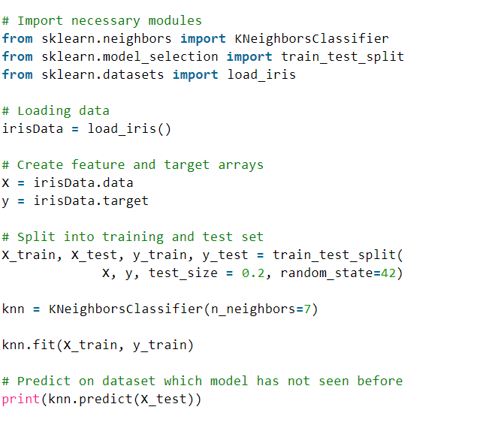
EXISTING ALGORITHM
(K-Nearest Neighbor algorithm)

Slide 13
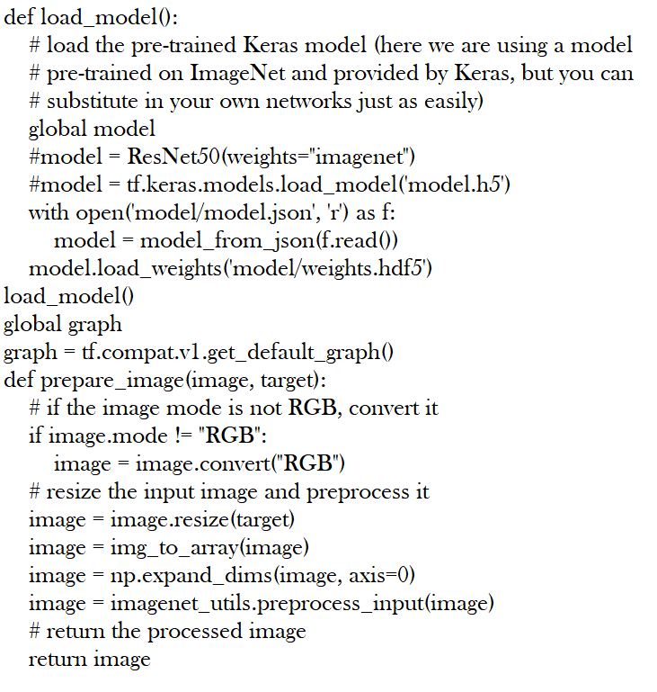
PROPOSED ALGORITHM
(Recurrent neural networks (RNNs))

Slide 14
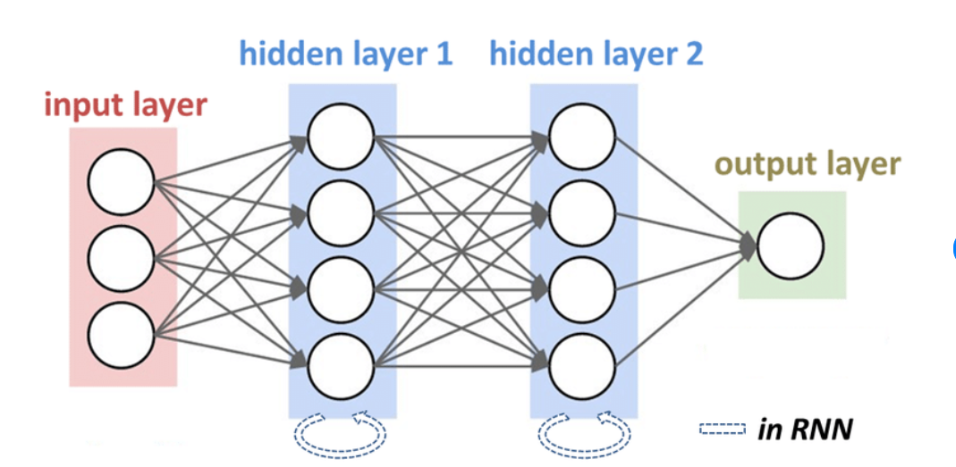
RECURRENT NEURAL NETWORK

Slide 15
SOFTWARE REQUIREMENTS
Front End – Anaconda IDE
Backend – SQL
Language – Python 3.8
HARDWARE REQUIREMENTS
Hard Disk: Greater than 500 GB
RAM: Greater than 4 GB
Processor: I3 and Above

Slide 16
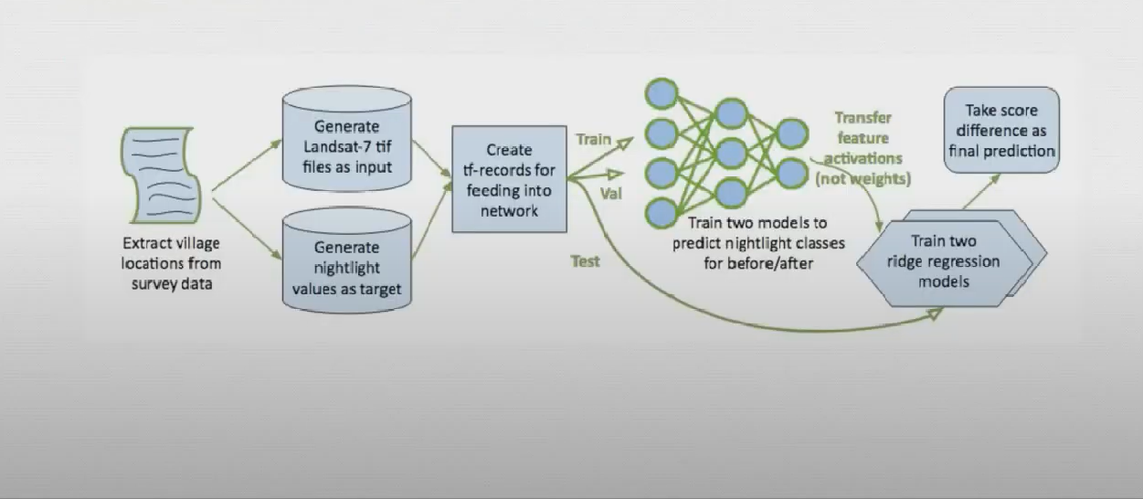
ARCHITECTURE DIAGRAM

Slide 17
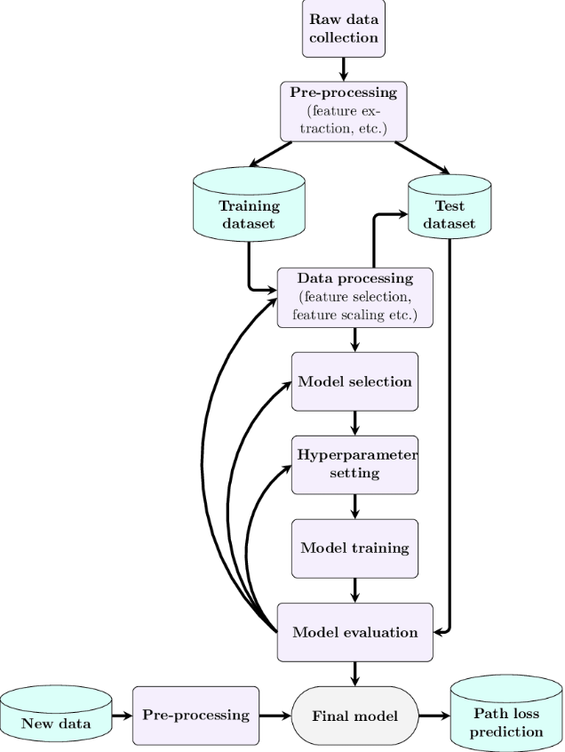
SYSTEM DESIGN – FLOW CHART

Slide 18
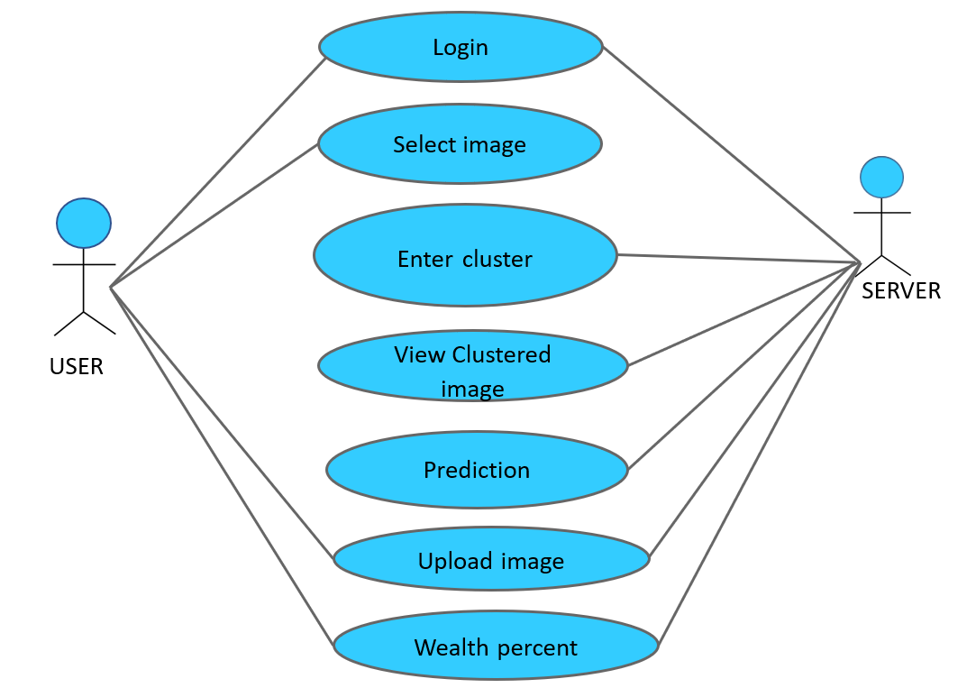
SYSTEM DESIGN – USE CASE DIAGRAM

Slide 19
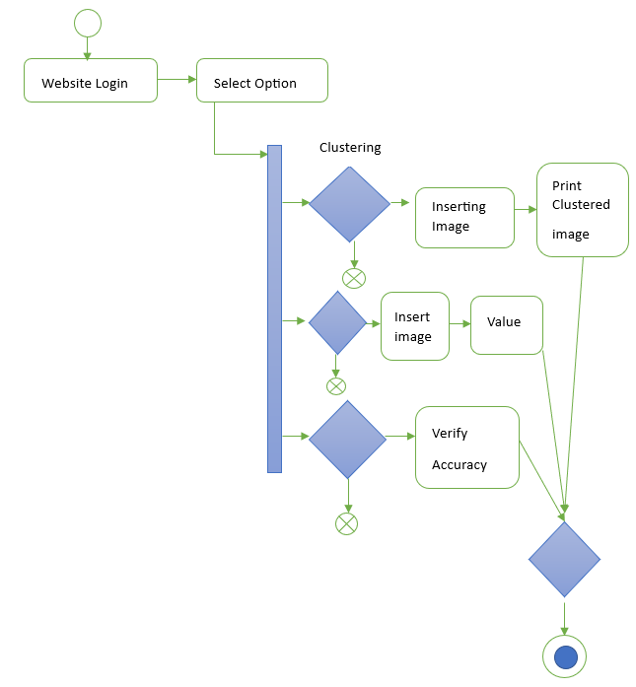
SYSTEM DESIGN – ACTIVITY DIAGRAM

Slide 20
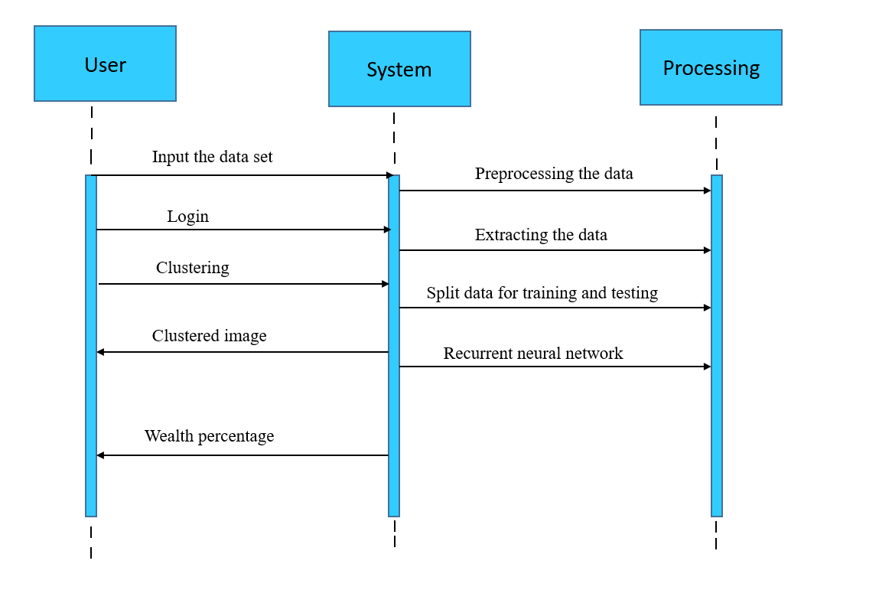
SYSTEM DESIGN – SEQUENCE DIAGRAM

Slide 21
Module Description
Home Page
After running the project code in anaconda prompt ,a URL link will be displayed in the terminal .
We have to copy that and paste it in any browsing website. At that time the project website will be opened.
The home page contains the full details of the project and having the login button by which we can get into the project with appropriate password.
Login Page
The login page contains the username and password input boxes in which we have to give the appropriate data to open into the next page.

Slide 22
Clustering Page
In this page ,we have to give a image input to cluster the places based on some criteria and map them with different colours.
This page will give a good visualization for the people for better understanding about the region.
Prediction Page
This will be the main core page, In which we have to give a image as input and the machine will predict the wealth of that area using recurrent neural network And give a wealth value at the bottom of the page.
Analysis Page
In this page, the project analysis i.e., the accuracy map and some analysis taken part .

Slide 23
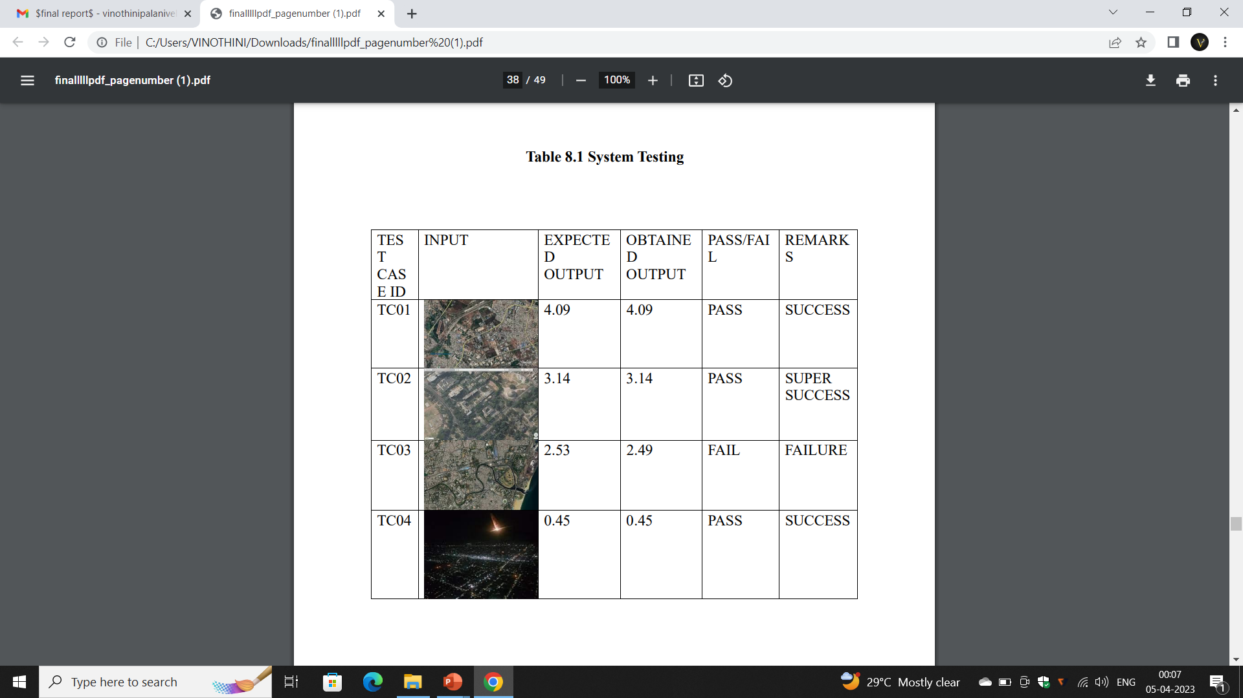
Testing /Performance Evaluation / Results

Slide 24
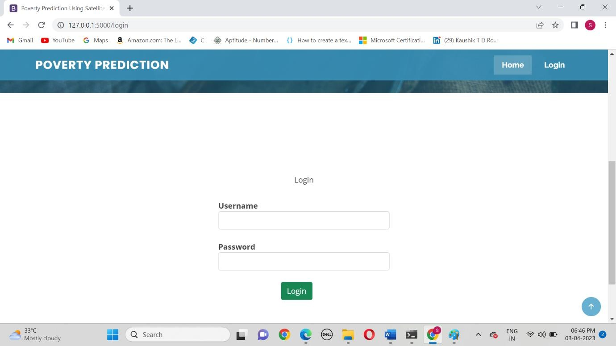
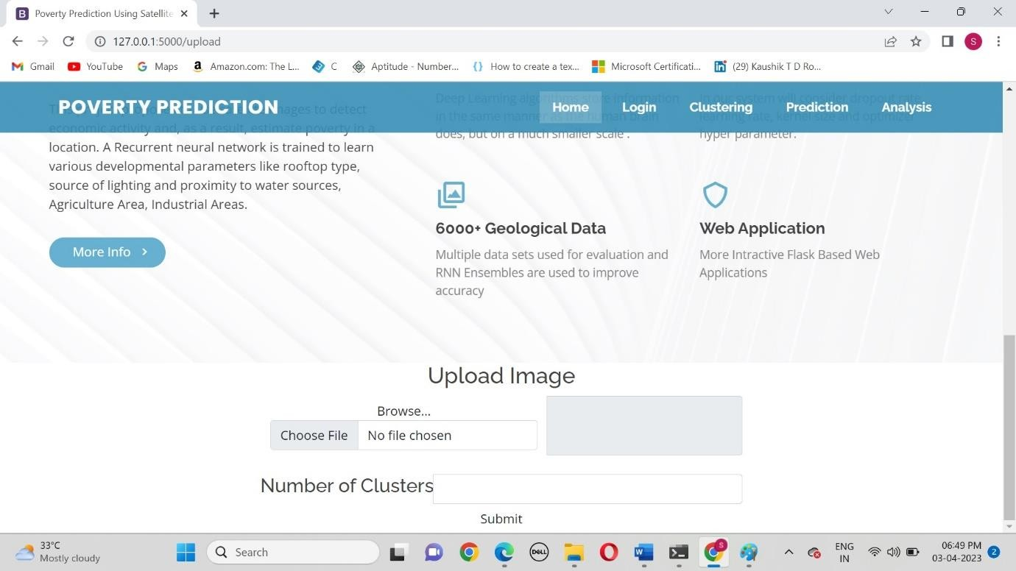
Screen Shots
1. Login Page
2. Clustering page

Slide 25
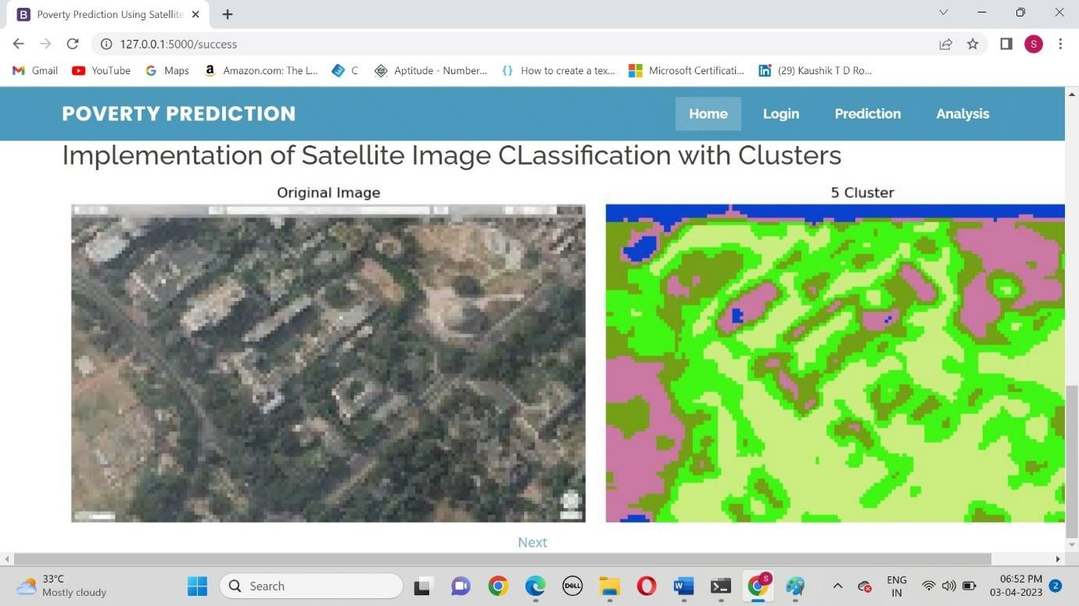
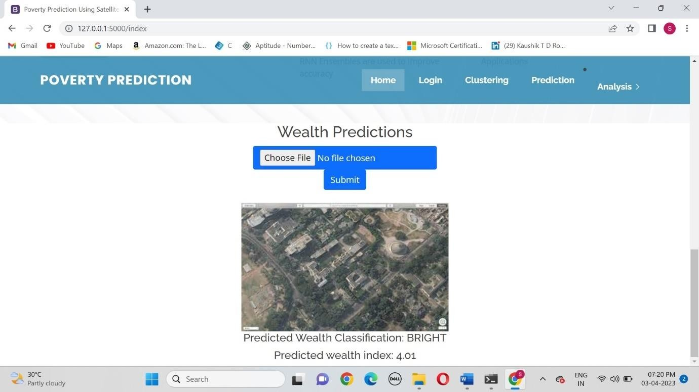
4. Wealth Prediction
3.Clustering the region

Slide 26
Conclusion
The goal of this Project was to examine a novel approach to poverty prediction using both daytime and night-time satellite images.
While there is more to do, we think our work can provide a basis for poverty prediction as well as show its potential.
Identifying regions of poverty is the first step on its reduction and believe this work has contributed.
Feature Enhancement
In future along with poverty level it will tell what wealth has to improve to get rid of poverty.
BASE PAPER LINK: https://drive.google.com/drive/u/0/folders/1ZpXZ84re-3hHPVp8TTbIVb16DJlcYM7r

Slide 27
REFERENCES
[1] S. S. A. Zaidi, M. S. Ansari, A. Aslam, N. Kanwal, M. Asghar, and B. Lee. A survey of modern deep learning based object detection models, 2021.
[2] C. Yeh, A. Perez, A. Driscoll, G. Azzari, Z. Tang, D. Lobell, S. Ermon, and M. Burke. Using publicly available satellite imagery and deep learning to understand economic well-being in africa. Nat. Commun.,11(1):2583, May 2022.
[3] Ayush. Kumar, Uzkent. Burak, Burke. Marshall, Lobell. David and Stefano Ermon, "Generating Interpretable Poverty Maps using Object Detection in Satellite Images", 2023.
[4] Varun Chitturi , Zaid Nabulsi. Predicting Poverty Level from Satellite Imagery using Deep Neural Networks, 2022.
[5] W. Gorr and R. Harries, ``Introduction to Poverty forecasting,'' Int. J. Fore- casting, vol. 19, no. 4, pp. 551555, Oct. 2023.

Slide 28
[6] Jonnadula Prasanna, Mounika Susarla, K. Suvarna Vani, Harsha Vardhan Govada.Prediction of Population Density & Poverty Rate Using Uncertain Mosaics with Satellite Imagery,2022.
[7] W. H. Li, L.Wen, and Y. B. Chen, ``Application of improved GA-BP neural network model in property Poverty prediction,'' Geomatics Inf. Sci. Wuhan Univ., vol. 42, no. 8, pp. 11101116, 2021.
[8] J. M. Caplan, L. W. Kennedy, and J. Miller, ``Risk terrain modeling: Brokering criminological theory and GIS methods for Poverty forecasting,'' Justice Quart., vol. 28, no. 2, pp. 360381, 2021.
[9] M. Cahill and G. Mulligan, ``Using geographically weighted regression to explore local Poverty patterns,'' Social Sci. Comput. Rev., vol. 25, no. 2, pp. 174193, May 2021.
[10] A. Almehmadi, Z. Joudaki, and R. Jalali, ``Language usage on Twitter predicts Poverty rates,'' in Proc. 10th Int. Conf. Secur. Inf. Netw. (SIN), 2021.

Slide 29
[11] H. Berestycki and J.-P. Nadal, ``Self-organised critical hot spots of criminal activity,'' Eur. J. Appl. Math., vol. 21, nos. 45, pp. 371399, Oct. 2021.
[12] K. C. Baumgartner, S. Ferrari, and C. G. Salfati, ``Bayesian network modeling of offender behavior for criminal proling,'' in Proc. 44th IEEE Conf. Decis. Control, Eur. Control Conf. (CDC-ECC), Dec. 2022, pp. 27022709.
[13] W. H. Li, L.Wen, and Y. B. Chen, ``Application of improved GA-BP neural network model in property Poverty prediction,'' Geomatics Inf. Sci. Wuhan Univ., vol. 42, no. 8, pp. 11101116, 2021.
[14] L. Lin,W. J. Liu, andW.W. Liao, ``Comparison of random forest algorithmand space-time kernel density mapping for Poverty hotspot prediction,'' Prog. Geogr., vol. 37, no. 6, pp. 761771, 2022.
[15] C. L. X. Liu, S. H. Zhou, and C. Jiang, ``Spatial heterogeneity of microspatial factors' effects on street robberies: A case study of DP Peninsula,'' Geograph. Res., vol. 36, no. 12, pp. 24922504, 2021.

Slide 30
THANK YOU

